Slide 1
Leica SP8X Confocal
Michael Blanchard Imaging Technician michael_Blanchard@hms.harvard.edu
Aurelien Begue
Aurelien_begue@hms.harvard.edu
Michelle Ocana
Michelle_ocana@hms.harvard.edu

Slide 2
Turn on procedure
keyboard
1
Turn on these buttons
Hg lamp under table
Turn on
2

Slide 3
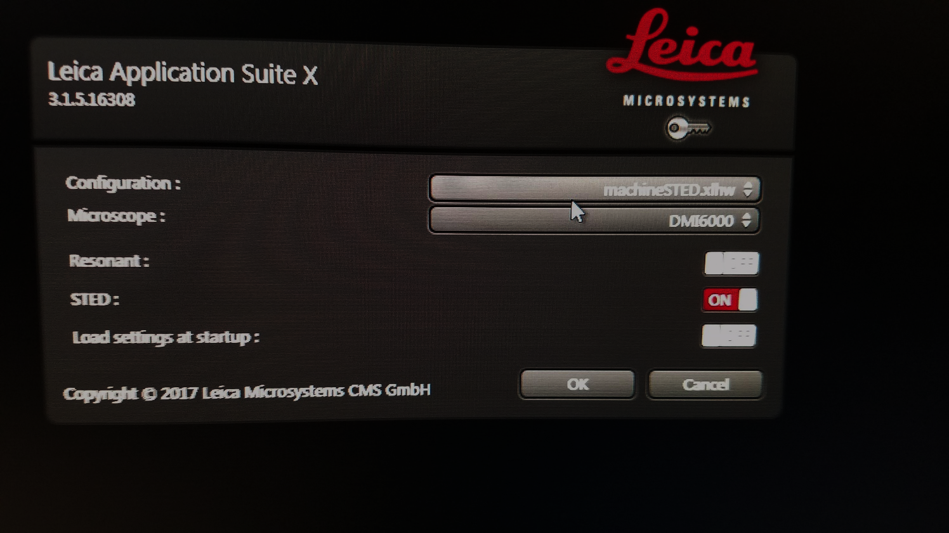
Software Startup
Click on LASX Icon
Load machineSTED.xlhw
Click OK

Slide 4
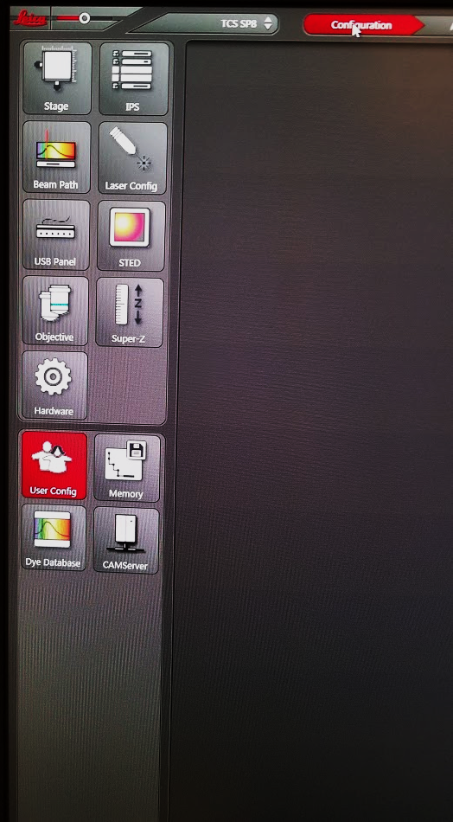
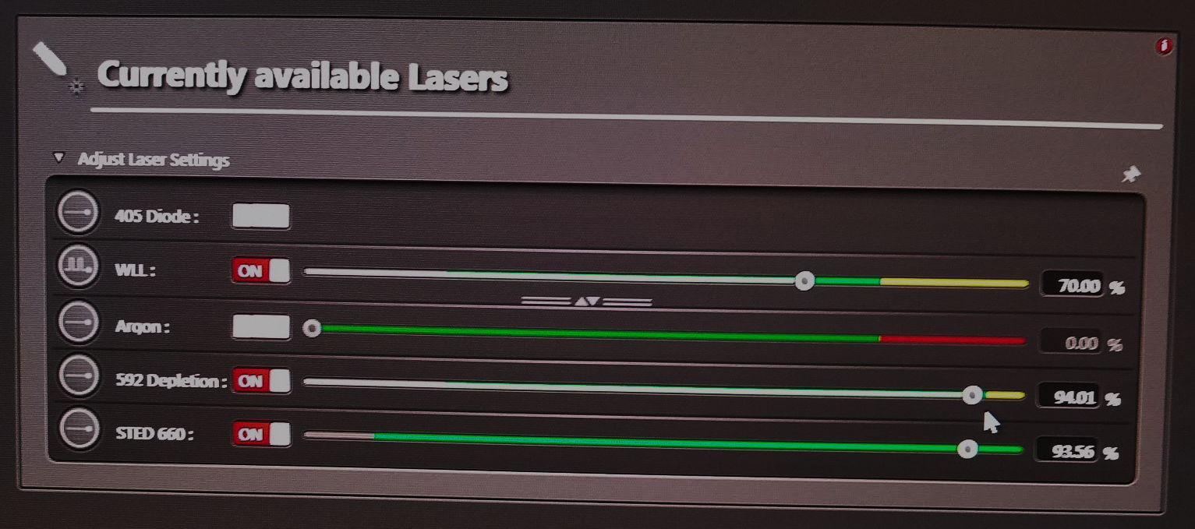
Using the software: Turning on Lasers
Click on the Configuration tab at the top of the application
Click on the “Lasers” button within configuration
Turn on your lasers and turn up the power

Slide 5
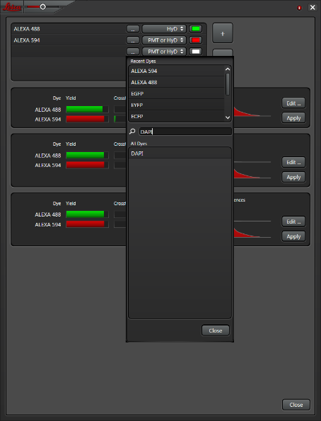
Using the software: Turning on Lasers
Click on the Acquire Tab at the top of the application
Choose your dyes in the Dye Path
Click the Dye path button to set up your filters

Slide 6
Imaging Resolution
Check your resolution
Are you resolving your particle?
Pixel size must be ½ the expected particle size
Adjust Format and Zoom Factor to improve pixel size
Adjust averaging to improve image quality (reducing noise)
Line average=higher quality but faster bleaching
Frame average = more fluorophore recovery

Slide 7
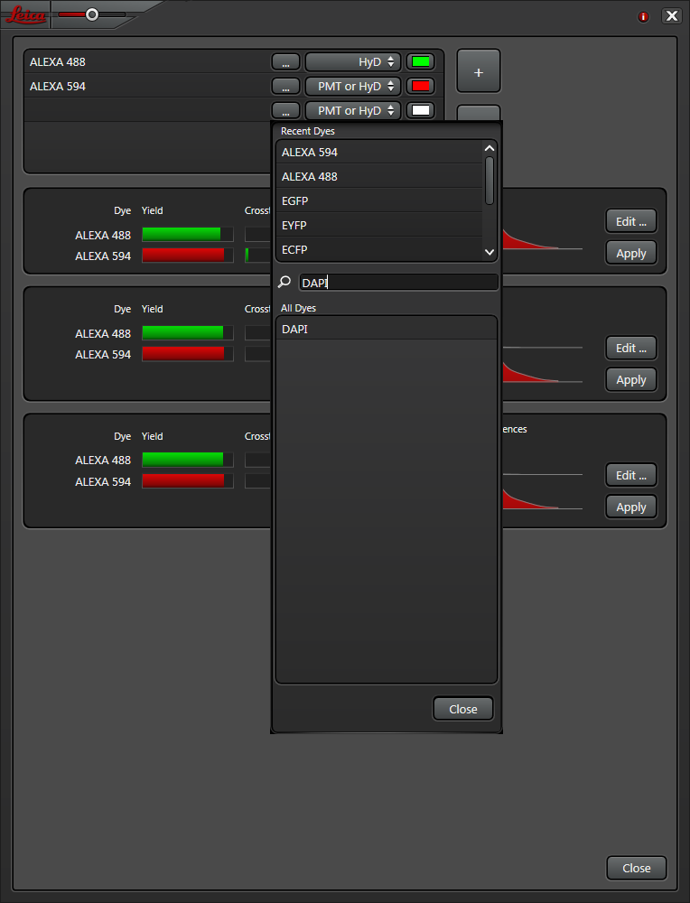
Choosing best dye and scan method
Choose PMT or HyD collection
Click on the … button to choose your dyes
Choose the best scan method(least crosstalk)

Slide 8
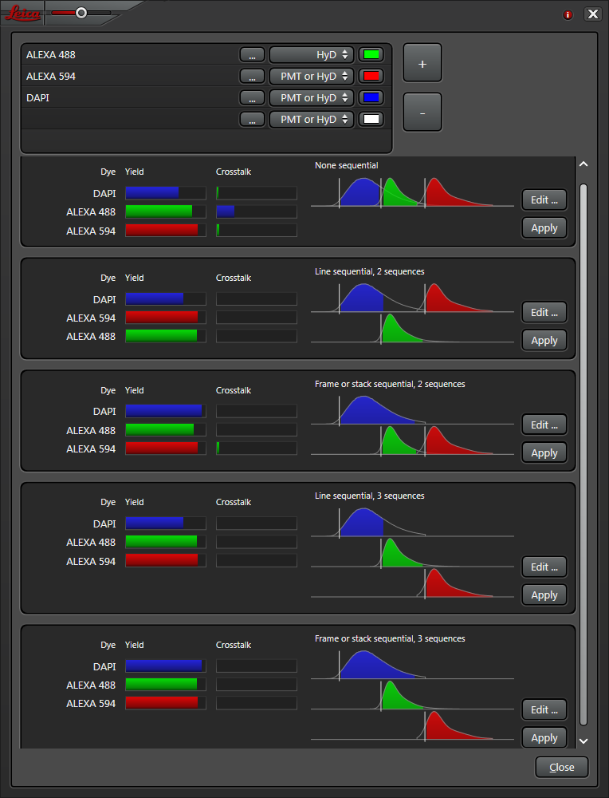
Choosing multichannel Sequences
These 3 settings do not have crosstalk
2 sequences will take less time than 3 sequences

Slide 9
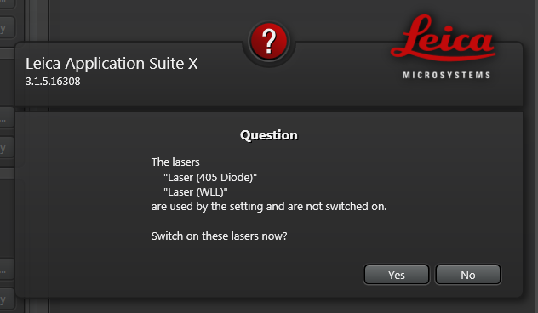
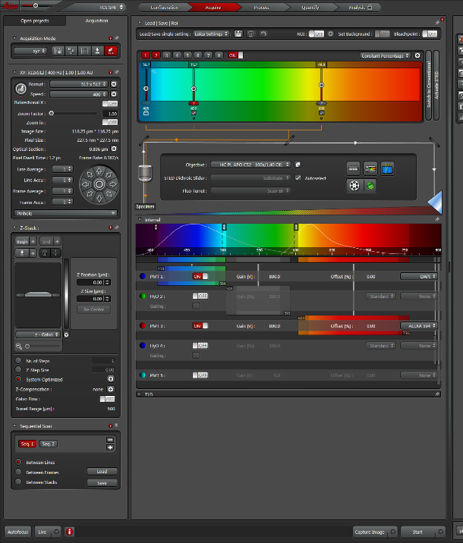
Turn up laser power
Turn on the lasers you wish to use. White light, STED, Argon/HeNe
Turn up laser powers (don’t leave them on 1%)
NOTE: White light laser is very low output. You will use more than standard confocal imaging

Slide 10
Z-Stacks
Use the microscope focus knob or the focus “knob” within the software
Click the begin and end when you have reached to top and bottom of your samples
Focus

Slide 11
***HyD Detector Gating***
Hybrid detection combines PMTs (photomultiplier tubes) with APDs (avalanche photo-diodes)
HyD use electron bombardment step with avalanche gain
Improves contrast
Improves signal to noise
Photon counting
Best for STED imaging
Timed gating between 1.5-7.0
Adjust as needed to improve photon selection

Slide 12
Scanning
Locate the scan buttons at the bottom of the application
Live: Fast continuous scan (for adjustments of laser power, gain and z focus)
Capture Image: Scans only the sequence you are looking currently working on
Start: Starts your scan

