Slide 1
VS120 Whole Slide Scanner
Neurobiology Imaging Facility
Michelle Ocana
Director
Michelle_ocana@hms.harvard.edu
O-617-432-1683
C-617-275-6390

Slide 2
Getting Started
Turn everything on
** If the PC is on , log out and log back in (to reset any network connections)
Fluorescent
Light source
power
EXFO
Camera Power
Hamamatsu
Remote
control
PC
Microscope
Stage and focus
control
UCB

Slide 3
Opening the Software
If the light source is cold started, wait 2 minutes until the green light stops blinking to turn on the software
Click on the ASW software icon. The software will boot and check equipment. You will see the stage move.
If there is an error, you forgot to turn something on.

Slide 4
Collecting Images
Choose the “Brightfield” or “Fluorescence” the wizard on the bottom of the program window.
Click on the “Expert” button

Slide 5
Collecting Images
Click on the Automatic load button.
Load sample into the position labeled you have your sample in.
Hit OK
Press Next

Slide 6
Image Name and Properties
Add Slide Name and any other identifiers in the text boxes
Click on the … button (highlighted) for Properties
Enter text here
More Stuff Button (Properties)

Slide 7
Choosing File Location and Format
Format
VSI for faster imaging
Save
Location
D: or F:

Slide 8
Choosing File Location and Format
Choosing substructure will allow
More naming options. Add naming
Identifiers that you think will be
Useful for locating and organizing
Your samples

Slide 9
Never save your images to the C: drive! They will automatically delete on reboot

Slide 10
Edit the Scanned Area
The overview (in low mag) will be visible
Check to make sure the entire area of the slide or Region of interest has been acquired
“Edit Scanned Area” to choose how much of the slide you want to acquire. You can acquire the entire slide or just a few regions
The Scanned Area will appear on the “Stage Navigator” in yellow

Slide 11
Edit the Scanned Area
Right click on the Image to delete Regions of Interest

Slide 12
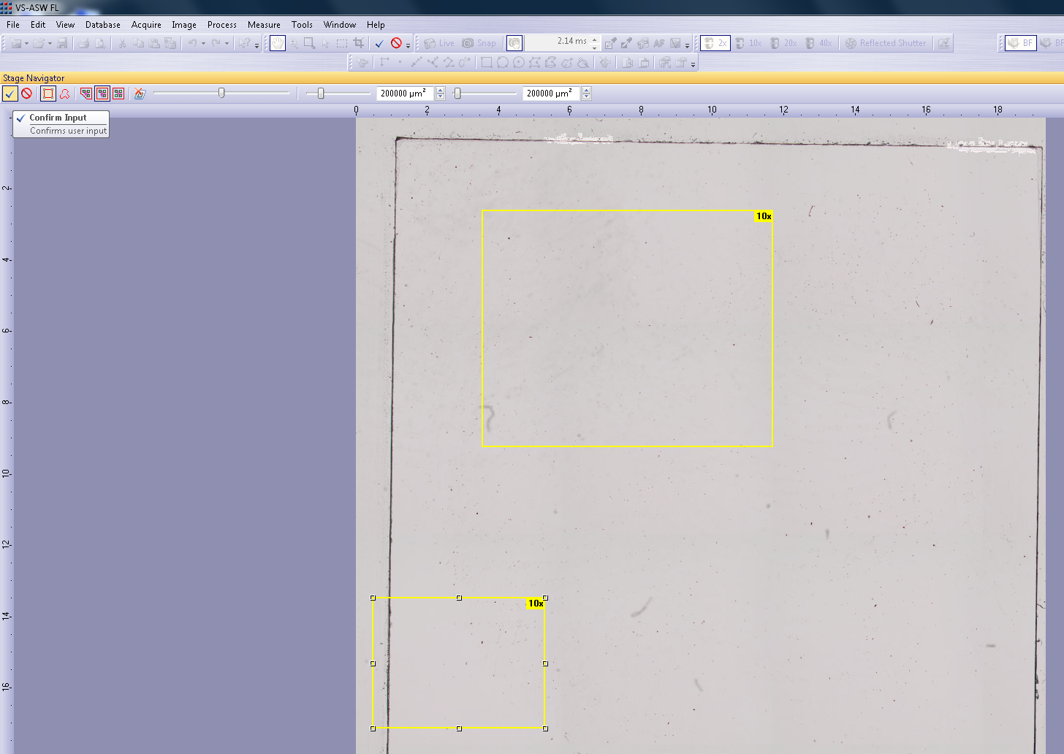
Edit the Scanned Area
Choose a drawing too and draw your regions
Confirm the new ROIs

Slide 13
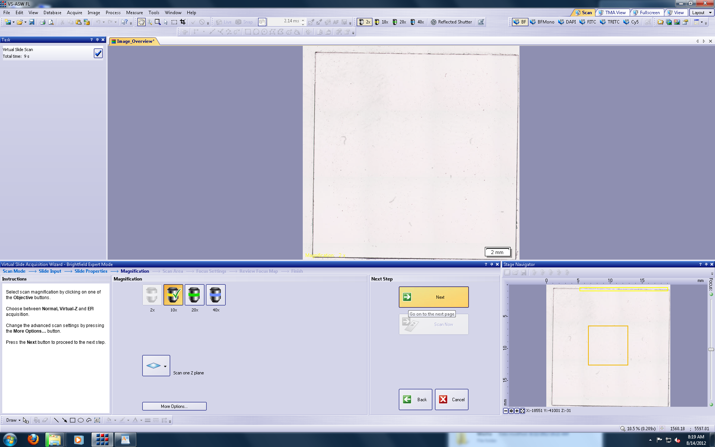
Acquiring the Slide
Choose Magnification
Click next when ready
Another chance to add properties and change save location

Slide 14
Focusing the Slide
Choose how often and what type of Autofocus (AF)
Grid Density: More AF positions or less. If your sample is not flat you may choose more
Focus Logic:
Autofocus-Without any assistance
Semi-manual-It will AF but request you to check it
Manual-You focus all positions

Slide 15
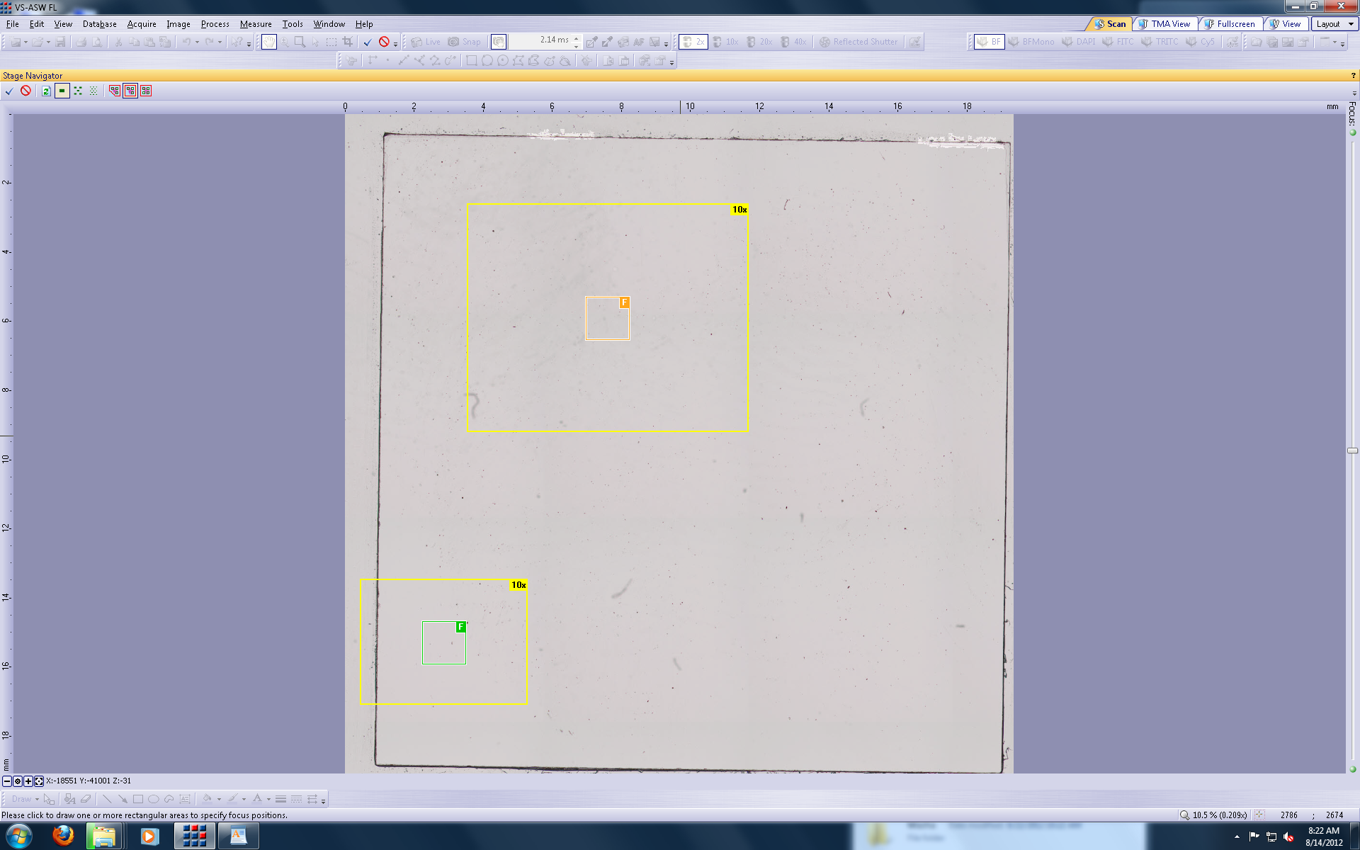
Edit Focus Map
Choosing the Edit Focus Map allows you to predefine where the AF will occur
You can choose to keep all AF positions or none of them and make your own
Click
Input
To
save
Choose a
different
grid density
Click on the image
to create a new
AF position

Slide 16
Acquiring the Scanned Image
Click “Scan Now” when AF is complete

Slide 17
Collecting Fluorescent Images
Choose the “Fluorescence” tab from the wizard on the bottom of the program window.
Click on the “Expert” button

Slide 18
Collecting Fluorescence Images
Choose Brightfield Overview (faster and no bleaching of sample)
Click on the small arrow to the right of the “Type” button and choose “Dim Sample”
Click Overview
**Optional** If you want to include the slide label click the dropdown to the right of the Overview arrow and click on Slide label
Brightfield Overview
Image Slide Label

Slide 19
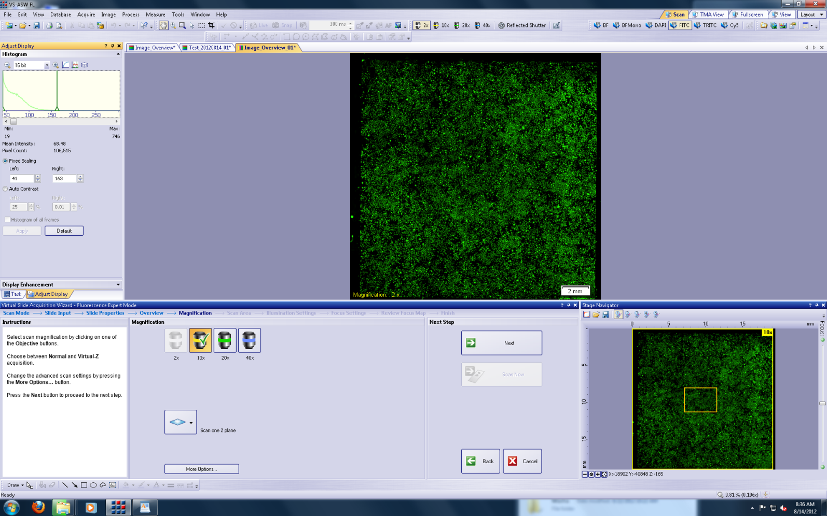
Scaling the Fluorescent Image
To make your Overview image look brighter
The image auto-scales the brightness upon completion of the Overview. This may not be desired.
Click on the “Fixed Scaling” button in Histogram window
Move the green line on the right to the left

Slide 20
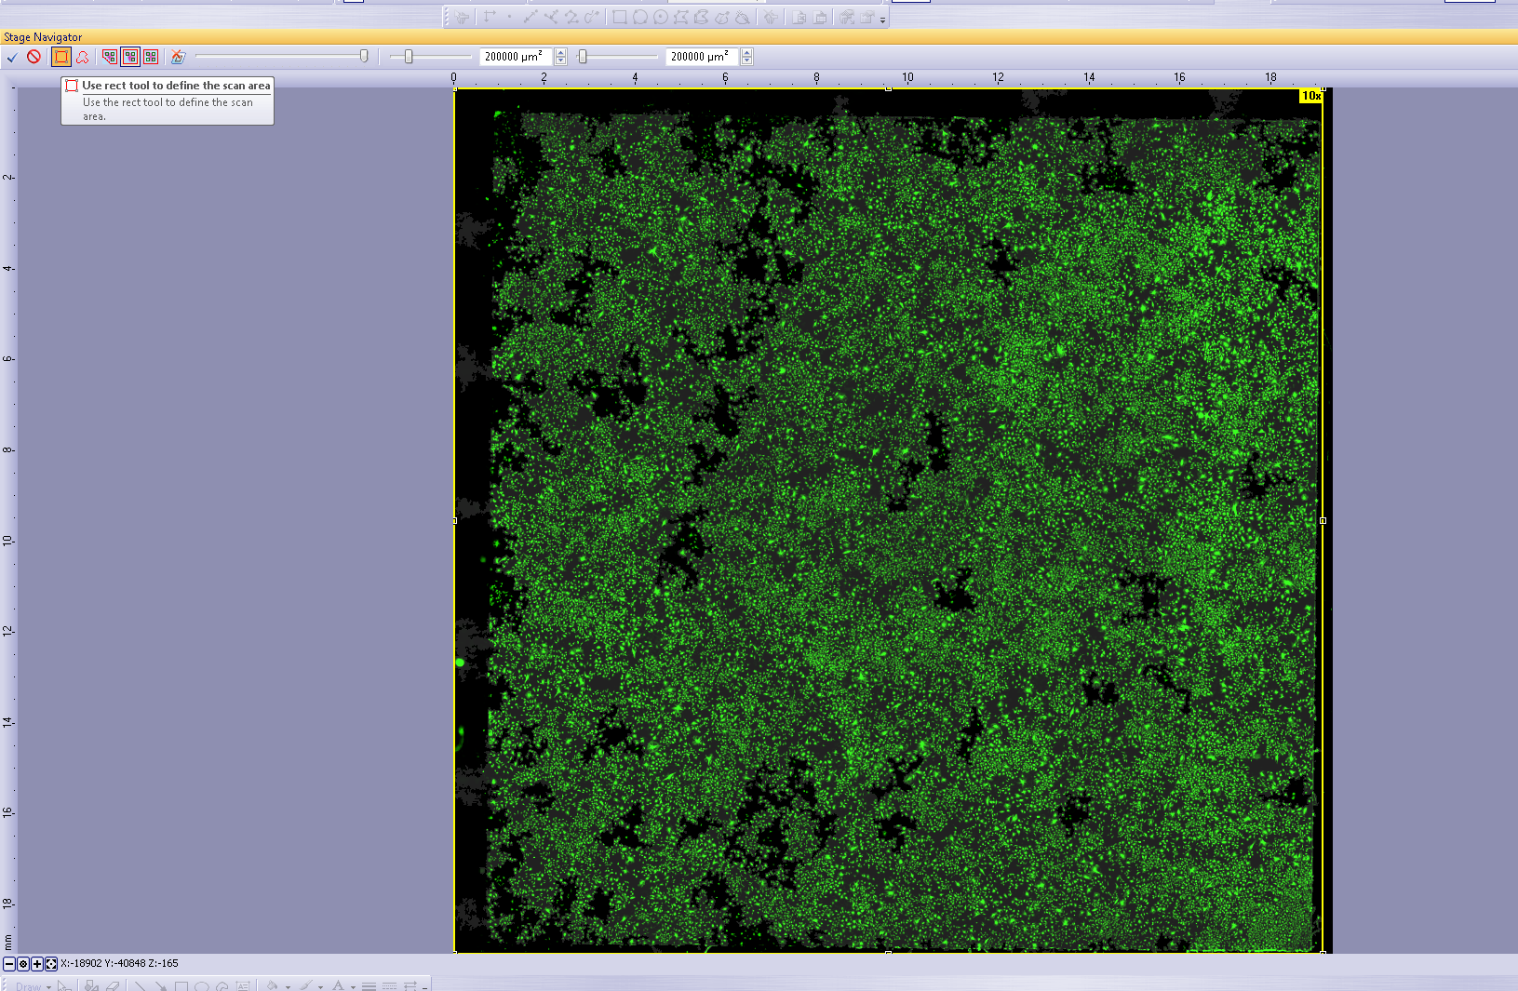
Edit the Scanned Area
Choose a drawing too and draw your regions
Or choose
the entire slide
Confirm the new ROIs

Slide 21
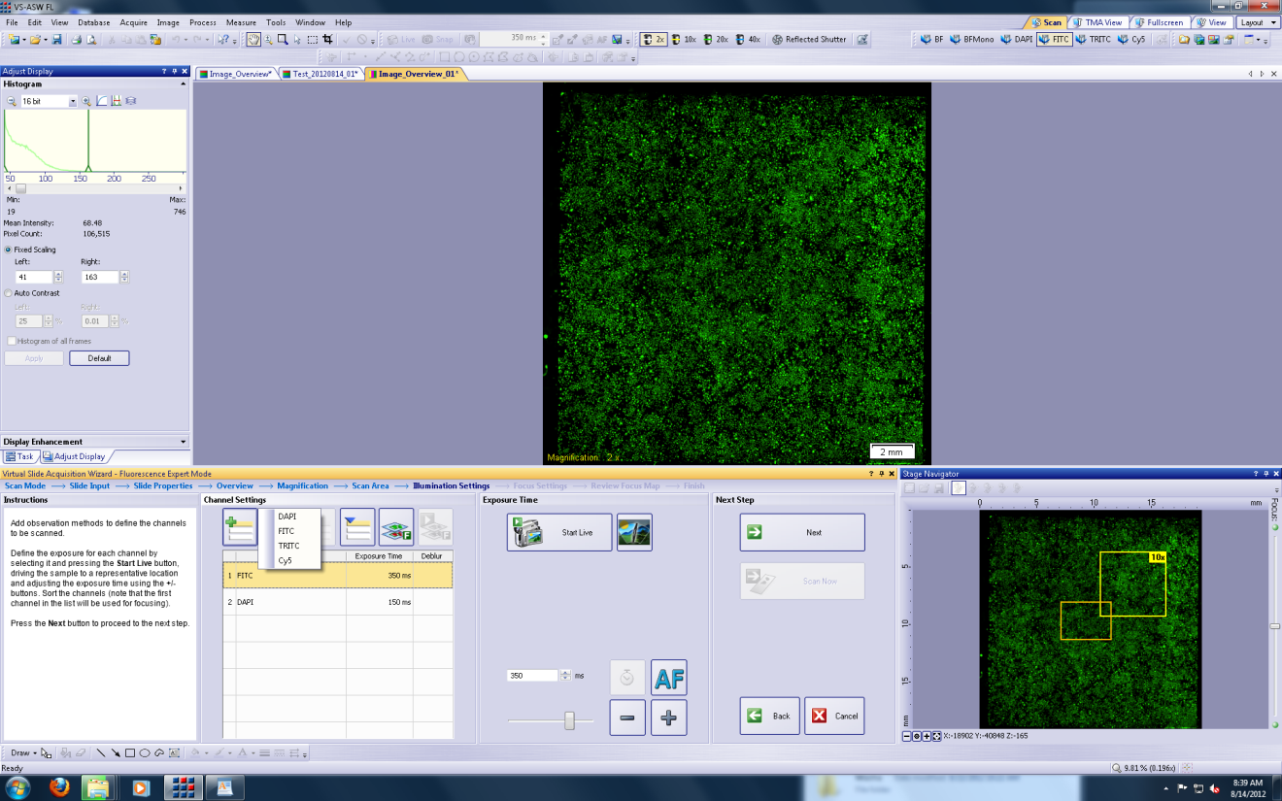
Choosing your Collection Wavelengths
Click on the + button to add a wavelength or the – to remove
Check each wavelength in “Start Live” mode and adjust the exposure time for each

Slide 22
Focusing the Slide
Choose how often and what type of Autofocus (AF)
Grid Density: More AF positions or less. If your sample is not flat you may choose more
Focus Logic:
Autofocus-Without any assistance
Semi-manual-It will AF but request you to check it
Manual-You focus all positions

Slide 23
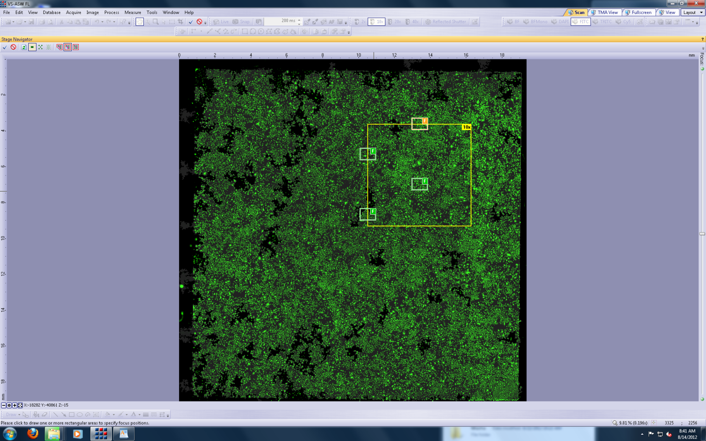
Edit Focus Map
Choosing the Edit Focus Map allows you to predefine where the AF will occur
You can choose to keep all AF positions or none of them and make your own
Click
Input
To
save
Choose a
different
grid density
Click on the image
to create a new
AF position

Slide 24
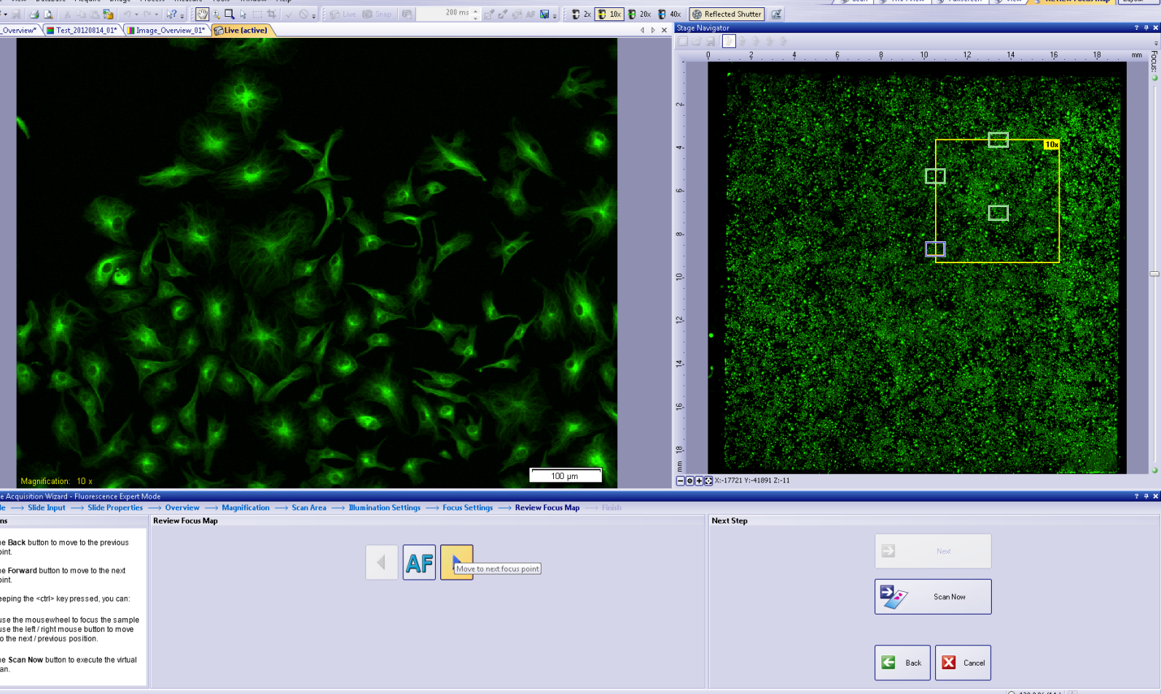
Choosing Semi-Manual Autofocus(AF)
The scope will move through the defines AF areas and pause
Manually adjust focus and click on the next arrow
The AF position will be highlighted on the Overview area to the right
“Scan Now” when finished
Live Focus
Image
Focus
Location
Defined
Scanning
Area

Slide 25
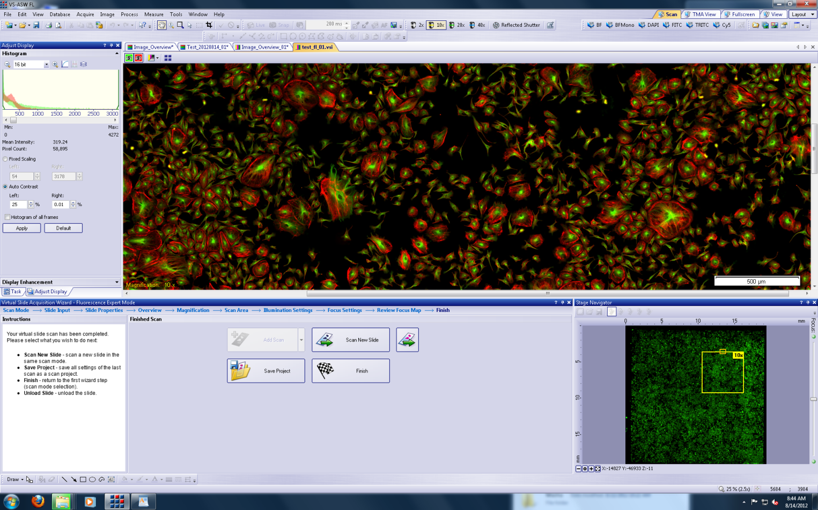
Final Scan
Scroll with the cursor on the Slide scan image to zoom in or out
Click Finish to complete
Click “Scan New Slide” to scan another with the same parameters
Load/Unload
Slide
Scan new
Slide
Finish

Slide 26
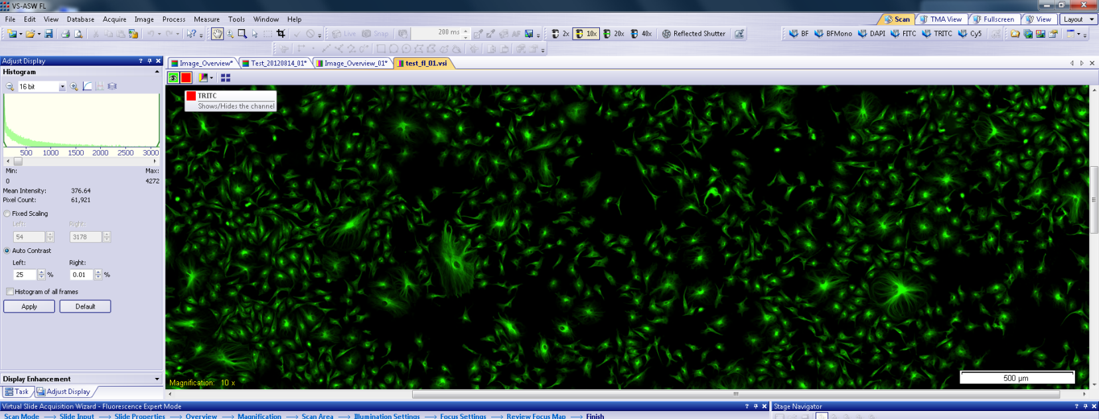
Adjusting Brightness/Contrast on Final Image
Composite (multi-color) images must be adjusted in monochrome (single color)
Turn off a color
Click the “Fixed Scaling” Radio button in the Histogram window
Drag the green line on the right to the left to adjust brightness
Turn off a
color
Adjust
Slider to
right

Slide 27
Shutting Down
Check the schedule at https://ppms.us/hms-neuroimaging/ to see if anyone is signed up after you
If there is someone with 2 hours of you then leave the light source on.
Restart the computer at the end of your session

