Slide 1
Choosing fluorescent dyes for STED

Slide 2
Important factors:
#1.5 coverslips ONLY
DAPI free mounting media
Refractive index matched mounting media (oil=1.518)
Acid-washed coverslips are preferable to flamed coverslips
Avoid “sealants” that can quench fluorescence or create autofluorescence (i.e. color nailpolish)

Slide 3
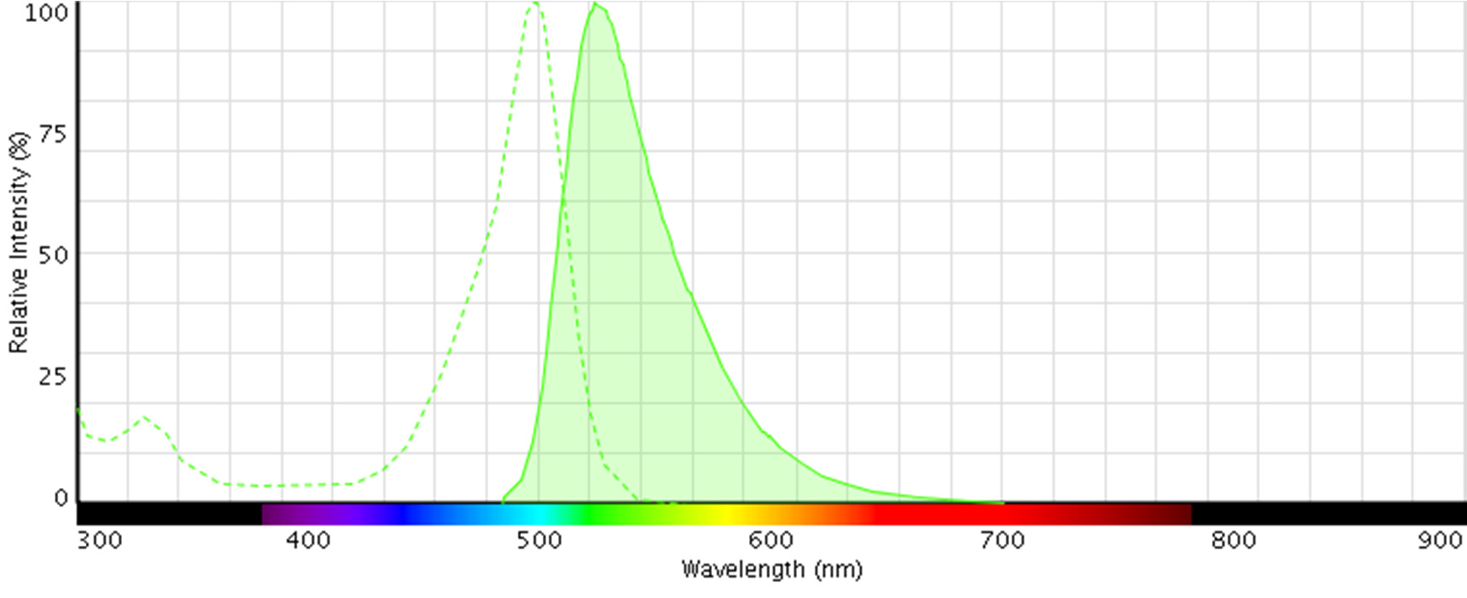
Single color STED
For STED to work efficiently, the emission spectra needs to show significant emission at the STED wavelength.
No excitation at the depletion laser wavelength
Ex: Oregon Green 488 for the 592 nm depletion laser ➔
Excitation @ 488 nm
Depletion @ 592 nm

Slide 4
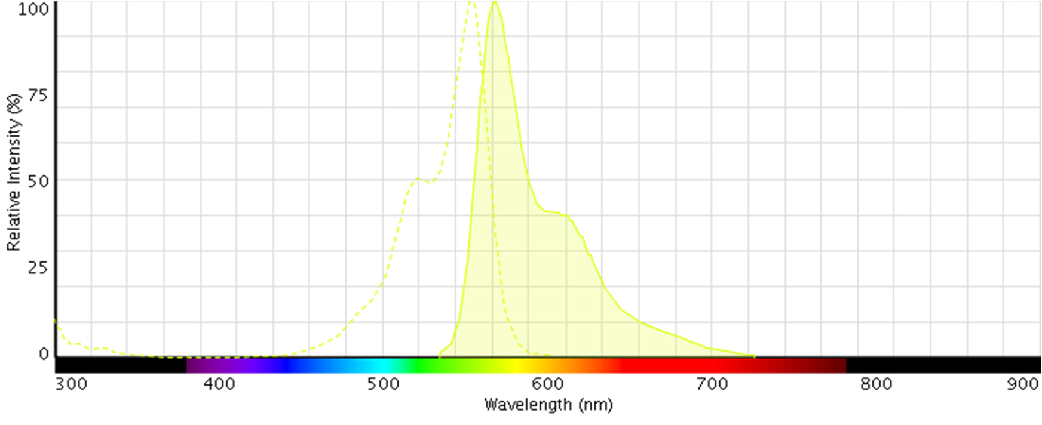
Single color STED
For STED to work efficiently, the emission spectra needs to show significant emission at the STED wavelength.
No excitation at the depletion wavelength.
Ex: Alexa 555 for the 660 nm depletion laser ➔
Excitation @ 555 nm
Depletion @ 660 nm

Slide 5
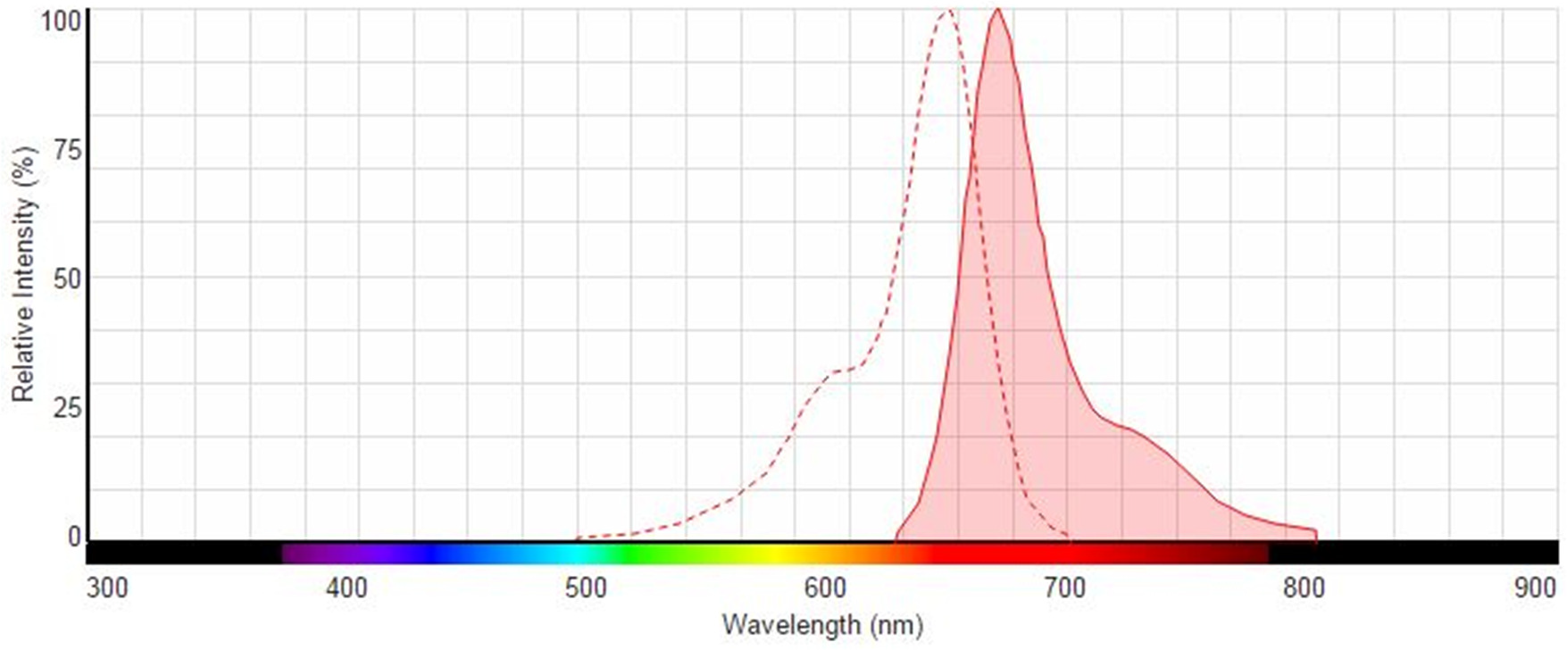
Single color STED
For STED to work efficiently, the emission spectra needs to show significant emission at the STED wavelength.
No excitation at the depletion wavelength.
Ex: Alexa 647 for the 775 nm depletion laser ➔
Excitation @ 647 nm
Depletion @ 775 nm

Slide 6
Recommended Single Dyes
Single color for 592 nm depletion
DyLight 488 or 514
Oregon Green 488 or 514
AlexaFluor 488 or 514
ATTO 488 or 514
Single color for 660 nm depletion
Alexa 532
ATTO 532 or 550
TMR/TRITC
Alexa 555
Single color for 775 nm depletion
ATTO 647N
Alexa 633
Alexa 594

Slide 7
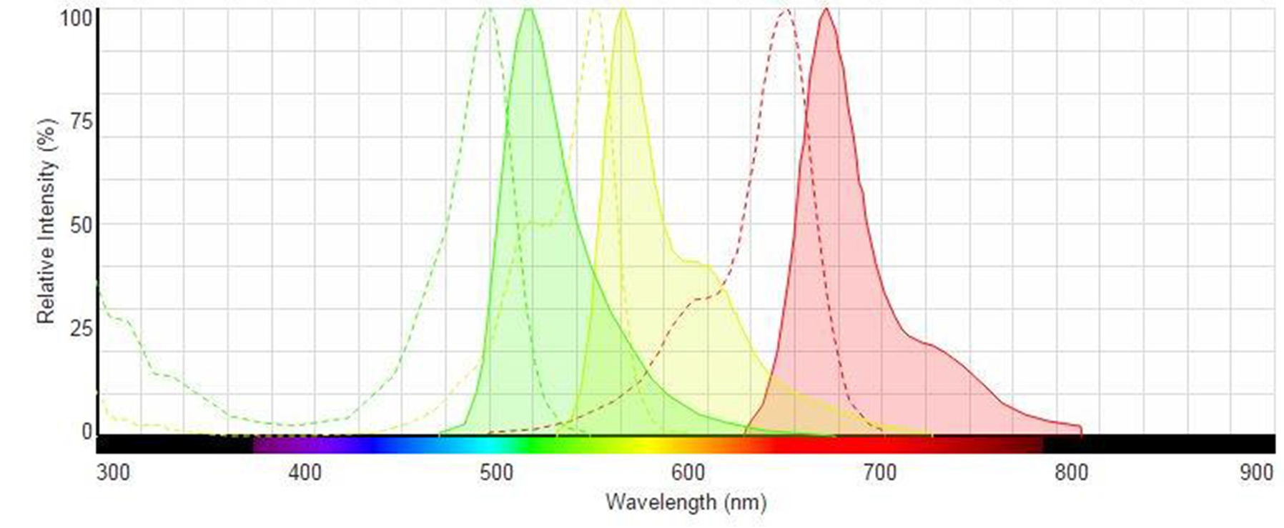
Multi-color STED
For STED to work efficiently, the emission spectra of both dyes need to show significant emission at the STED laser wavelengths.
Ex: Alexa 647, Alexa 555 and OG 488 for the 775nm, 660 nm and
592 nm depletion laser ➔
Sequence 1:
Excitation @ 647 nm
Depletion @ 775 nm
** Rule: “Image far red ➔➔➔ red” ALWAYS start your sequential 775/660 nm STED scans with the LONGER WAVELENGTH dye
and the 775nm depletion laser!!! The 660 nm depletion laser may bleach orange/red dyes.
Leica Microsystems 2015

Slide 8
Multi-color STED
For STED to work efficiently, the emission spectra of both dyes need to show significant emission at the STED laser wavelengths.
Ex: Alexa 647, Alexa 555 and OG 488 for the 775nm, 660 nm and
592 nm depletion laser ➔
Sequence 2:
Excitation @ 555 nm
Depletion @ 660 nm
** Rule: “Image red ➔➔➔ blue” ALWAYS start your sequential 660/592 nm STED scans with the LONGER WAVELENGTH dye and the 660 nm depletion laser!!! The 592 nm depletion laser may bleach orange/red dyes.
Leica Microsystems 2015

Slide 9
Multi-color STED
For STED to work efficiently, the emission spectra of both dyes need to show significant emission at the STED laser wavelengths.
Ex: Alexa 647, Alexa 555 and OG 488 for the 775nm, 660 nm and
592 nm depletion laser ➔
Sequence 3:
Excitation @ 470 nm
Depletion @ 592 nm
** Rule: “Image red ➔➔➔ blue” ALWAYS start your sequential 660/592 nm STED scans with the LONGER WAVELENGTH dye and the 660 nm depletion laser!!! The 592 nm depletion laser may bleach orange/red dyes.
Leica Microsystems 2015

Slide 10
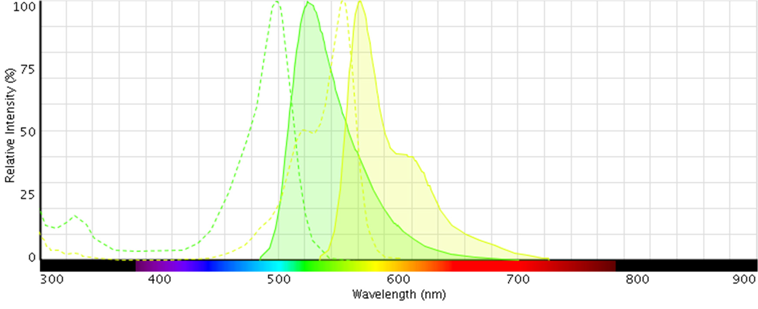
Multi-color STED – 1 STED laser
For STED to work efficiently, the emission spectra of both dyes need to show significant emission at the STED laser wavelengths.
Ex: Alexa 555 and OG 488 for the 660 nm depletion laser ➔
Excitation @ 470 nm
Excitation @ 555 nm
Depletion @ 660 nm
** Dyes with similar emission spectra to OG488 will show resolution improvement with the 660nm
laser, but the optimal super-resolution will be obtained with the 592nm laser.
Leica Microsystems 2015

Slide 11
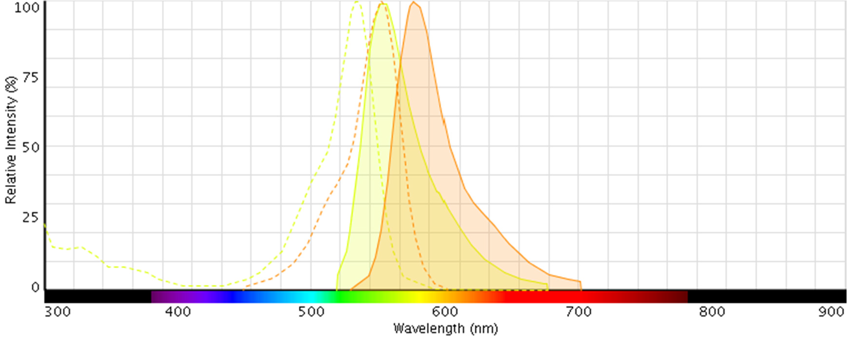
Multi-color STED – 1 STED laser
For STED to work efficiently, the emission spectra of both dyes need to show significant emission at the STED laser wavelengths.
Ex: Alexa 532 and TMR for the 660 nm depletion laser ➔
Excitation @ Excitation @ 514 nm 580 nm
Depletion @ 660 nm

Slide 12
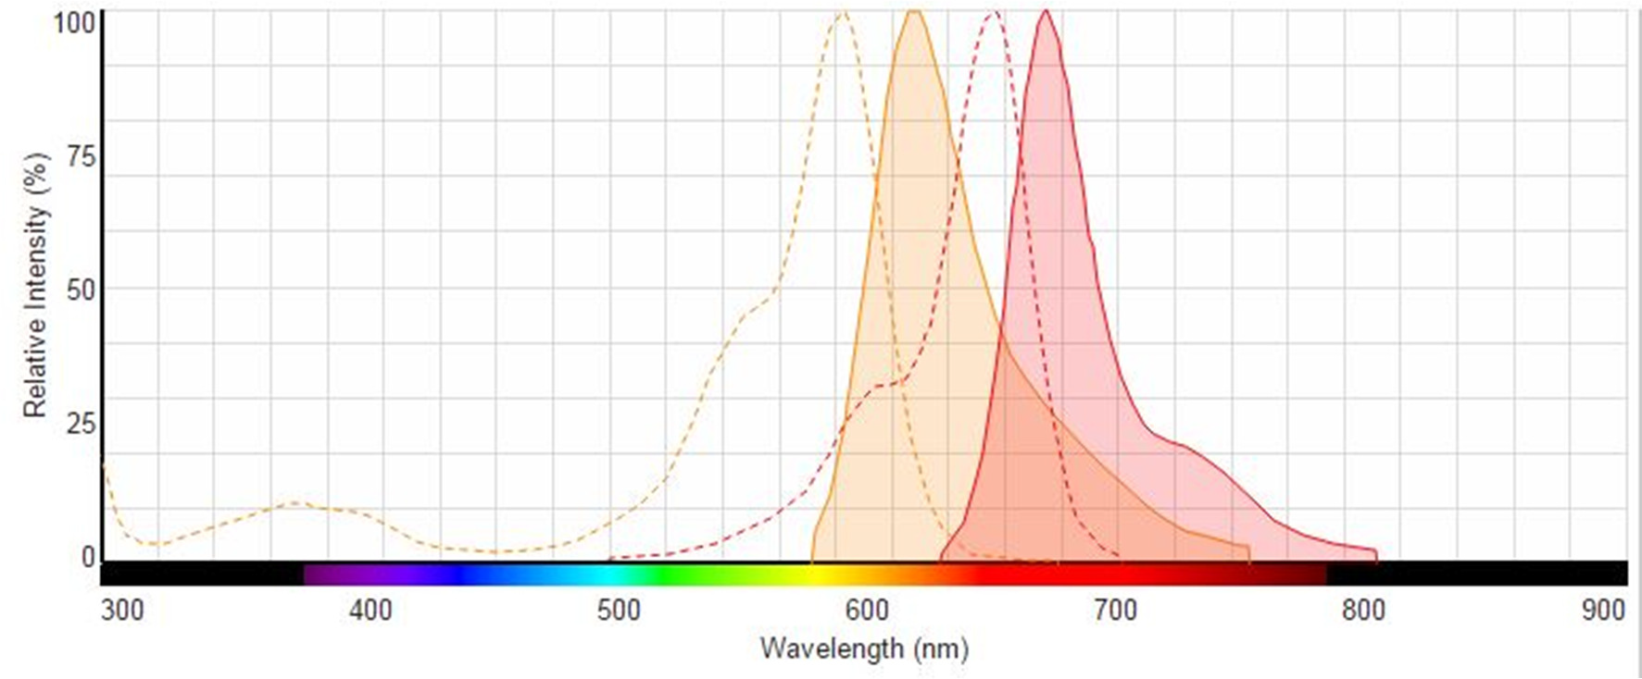
Multi-color STED – 1 STED laser
For STED to work efficiently, the emission spectra of both dyes need to show significant emission at the STED laser wavelengths.
Ex: Alexa 594 and Alexa647 for the 775 nm depletion laser ➔
Excitation @ 580 nm
Excitation @ 660 nm
Depletion @ 775 nm

Slide 13
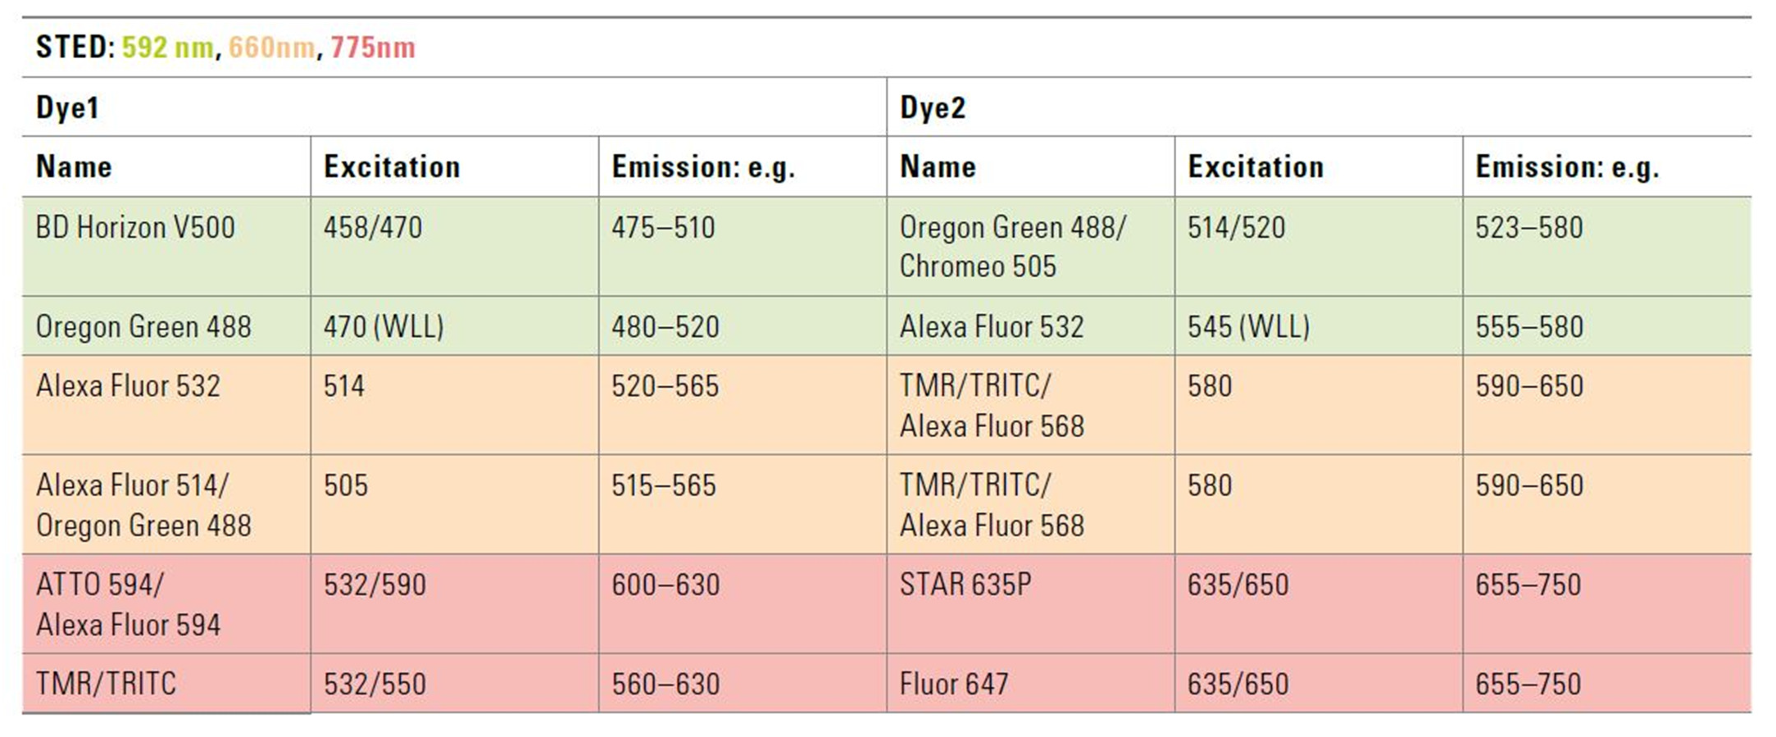
gated STED
Examples of dual color acquisition for selected dyes pairs, and spectra:

Slide 14
gated STED
Examples of triple color acquisition for selected dyes pairs, and spectra:

Slide 15
Increase Primary and Secondary Concentrations
Increase your normal working concentrations of both primary and secondary antibodies!
We recommend most concentrations be about 1:100 for primary and 1:50 – 1:200 for secondary
It is always better to start with higher concentrations of antibodies for the first samples, to rule out some issues with labeling density
Examples:
Oregon Green 488 (1:100) (Life Technologies) Goat α-mouse (O- 11033) or α-rabbit (O-11038)
Alexa Fluor 488 (1:100) (Life Technologies) Goat α-mouse (A-11001)
or α-rabbit (A-11008)
Alexa Fluor 532 (1:100) (Life Technologies) Goat a-mouse (A-11002) or a-rabbit (A-11009)
Alexa Fluor 555 (1:100) (Life Technologies) Goat a-mouse (A-11031)
or a-rabbit (A-11011) or a-chicken (A-11041)
Tetramethylrhodamine (TRITC) (1:100) (Life Technologies) Goat α- mouse (T-2762) or α-rabbit (T-2769)

Slide 16
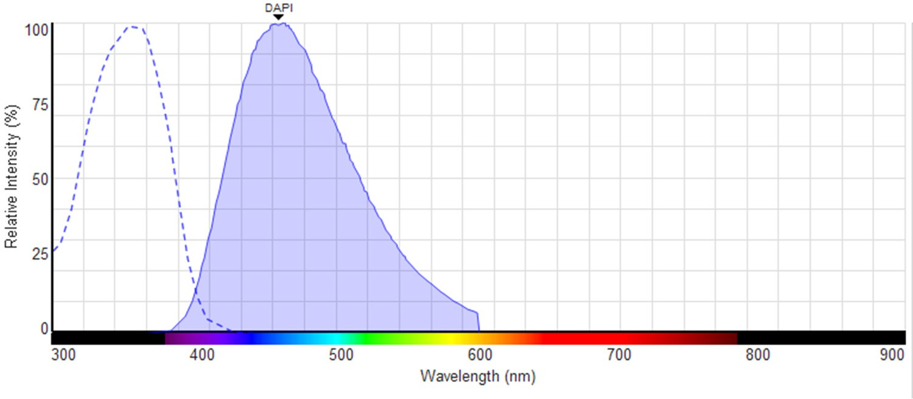
Do not use:
Other fluorescence Proteins not excitable by any laser lines from the Argon laser – STED CW (458, 476, 488, 514nm) or with the WLL gSTED between 470 and 580 nm.
DAPI (replace with TO-PRO-3, YOYO-3, PicoGreen)
QDOTs or other fluorophores excited by the 405 nm laser
592nm

Slide 17
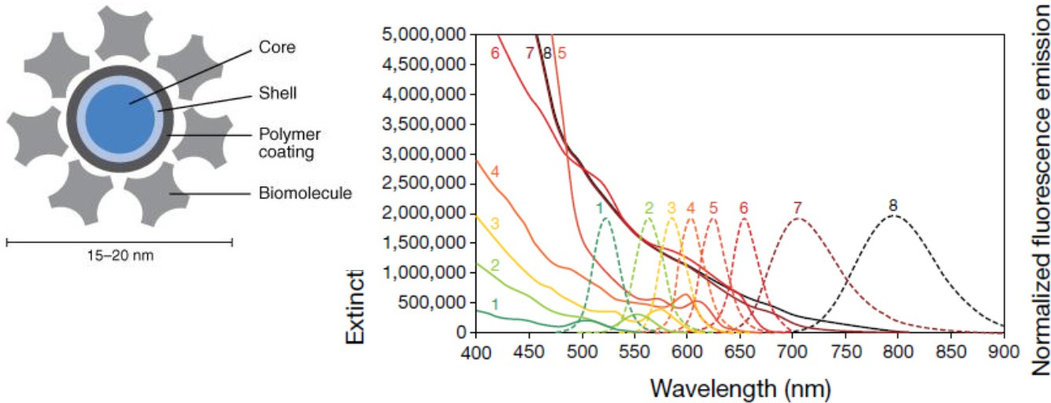
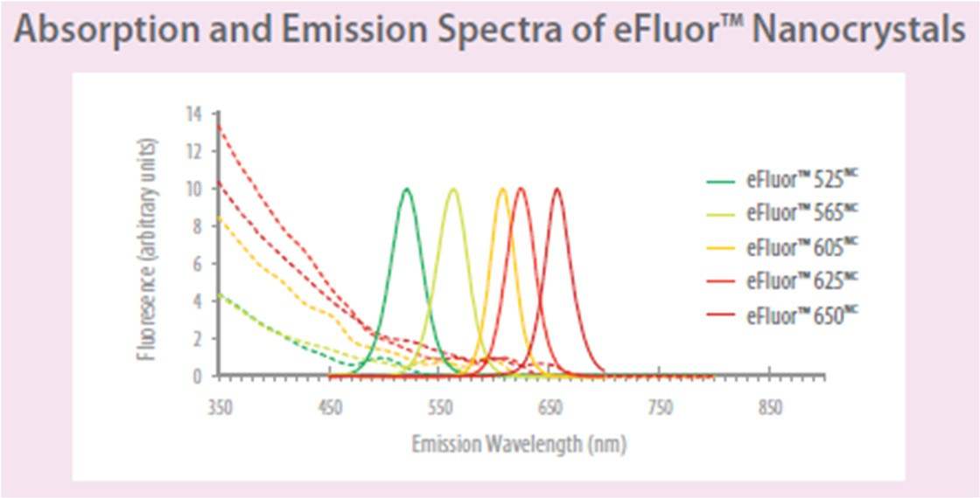
Nanocrystals (Quantum Dots - eFluor)
Emission Spectrum
Size & composition
FWHM 25
High photostability
Large extinction coefficients
o 130.000 – 2.900.000 M⁻¹cm⁻¹ @ 488nm
Fluorescein: 80.000 M⁻¹cm⁻¹
Excitation @ 592nm 3-9% of maximum
Not a too good idea because they have a very narrow emission and broad absorption spectrum.
Up to now, they never worked

Slide 18
Sample Mounting

Slide 19
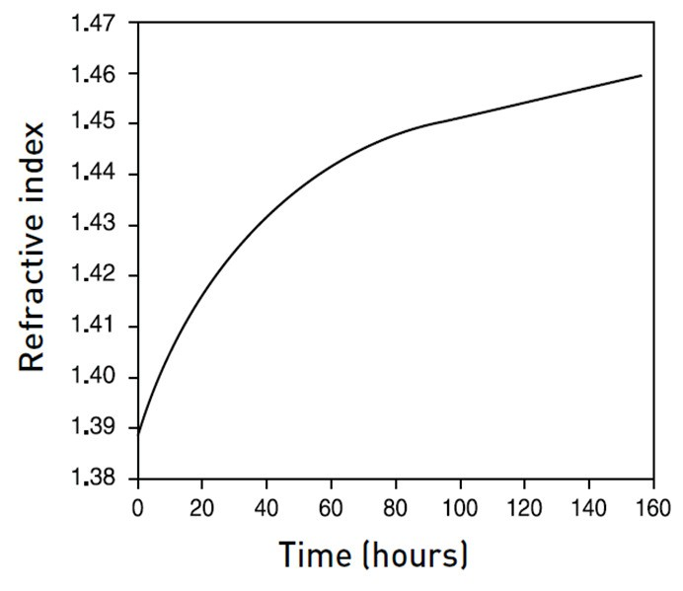
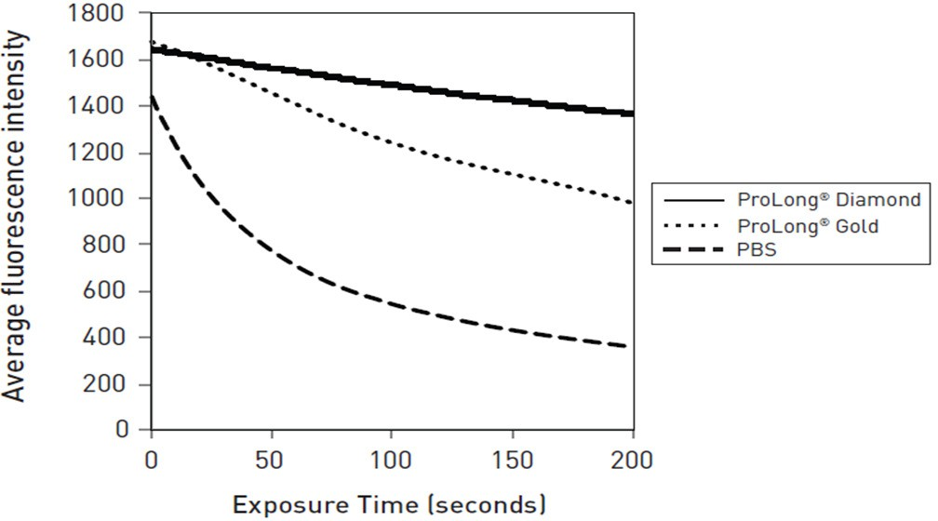
Mounting Media
With cell culture and thin tissue sections
Prolong® Diamond Antifade Mountant (Life Technologies)
Protects fluorescent dyes and fluorescent protein from fading, across entire visible and IR spectrums
Ready-to-use liquid that cures for longer-term storage (polymerizes, so no sealant needed)
Ideal for Alexa Fluor® and traditional dyes, such as FITC and Cy®3, and fluorescent proteins like GFP, RFP, and mCherry
Mounted samples are stable for months
Maintains fluorescence signal—little to no quenching
LLeeiiccaa MMicicrorosysystsetemms s20210415

Slide 20
Mounting Media
With thick tissue sections
Thiodiethanol (TDE, Sigma, #88559) mixed with an anti-fade reagent has been used with good results, especially for deep imaging.
The TDE concentration must be gradually enhanced (up to 97%) to obtain a final refractive index of 1.514
Sequential steps in TDE 50%, 70% (15-30 minutes at each step), then in 97%
+ antifade as final mounting media must be undertaken.
The coverslip must be sealed using invisible nail polish or other sealants.
Be sure that the sealant is not quenching your fluorescence or creating any autofluorescence.
Prolong only if the structure of interest is close from the coverslip. (closer than 25 µm)

Slide 21
STED CW and gated STED – Mounting Media
Thiodiethanol preparation for tissue mounting
(TDE, Sigma #88559)
6 Well-plate TDE 25% TDE 50% TDE 75%
TDE 80% + Antifade for GFP TDE 97% + Antifade
15-30 minutes incubation at each step (depending of the section thickness)
Mix very well the antifade (pipette in and out) with the TDE 97% prior to mount the tissue sections (eliminate the bubbles by centrifugation)
Use nail polish (high quality uncolored nail polish) on the #1.5 coverslip corner to keep it in place for the night (must be kept flat).
Seal the coverslip edges the following morning with nail polish.

Slide 22
General STED Workflow
Cells or tissue
Coverslip #1.5 or glass Fluorescence (1, 2 or 3 colors)
bottom dishes #1.5
Coverslip # 1.5
Chosen protocol?
Sample thickness is ≤ 20μm
Mowiol (+/- Antifade)
Prolong Diamond
Fluoromount
Mounting media?
Sample thickness is ≤ 20μm
Mowiol (+/- Antifade)
Prolong Diamond
TDE + Antifade

Slide 23
TCS STED CW and gSTED – Tips and Tricks received by customers
DRAQ 5 in a dilution of 1:5000 works well with TDE and p-Phenylenediamine (PPD) seems to be the most effective antifade mixed; no fading or bleaching at high depletion power.
At more concentrated amounts DRAQ 5 mounted with Prolong, customer noticed very strange results in the green channel; Draq gets much brighter; there is some kind of photo conversion in prolong.
Excitation peak ~650nm
TDE de-polymerizes F-actin so isn't suitable for that.
TDE works well with any antibody (best if you post fix the sample prior to mounting).
However, it does not work with reagents that can diffuse away - e.g. phalloidin, To-Pro3, etc.

